Slide 1
LogPress: Optimized Compression and Retrieval of Unstructured Logs
Neel Dudheliya
Tanay Gandhi
Pranav Jibhakate
Notes:
Good morning My name is Tanay and I alongside my teammates Neel and Pranav we will present LogPress: Optimized Compression and Retrieval of Unstructured Logs

Slide 2
Table of content
Introduction
Methodologies
Chunking Approach
Clustering Approach
Distributed chunking
Experimental Setup
Test Results
Conclusion
Notes:
Now, let's take a look at the table of contents. We’ll begin with an overview to the problem. Then, we will dive deep into the methodologies used. We will present the naïve approach and the three primary approaches to log compression namely chunking, clustering and distributed chunking approach After that, we will present our experimental setup followed by the test results, and finally, we’ll conclude with key takeaways

Slide 3
The Problem
Storage Efficiency: Log files consume significant disk space, leading to high storage costs and backup complexities.
Search Performance: Finding specific information in large log archives is time-consuming, especially when logs are compressed using standard methods that require full decompression before searching.
Pattern Redundancy: Log files contain highly repetitive patterns with small variations (timestamps, IDs, etc.), but general-purpose compression algorithms don't fully exploit this structural redundancy.
Resource Constraints: Processing large log volumes requires significant CPU and memory resources, especially during search operations.
Original Structure Preservation: Compression should maintain log order and structure for accurate analysis and debugging.
Notes:
Unstructured log files pose several significant challenges.
First, they consume a lot of space, resulting in high storage and backup costs.
Search performance is another issue, as finding specific information in large logs can be time-consuming, especially when traditional compression methods require full decompression before searching.
Logs often contain repetitive patterns, such as timestamps or IDs, but standard compression algorithms fail to exploit this redundancy efficiently.
Additionally, processing large log volumes requires substantial CPU and memory resources, particularly during search operations.
Finally, maintaining the original structure of the logs is crucial to ensure accurate searching and decompression.
These challenges highlight the need for an solution like LogPress, which addresses both compression and retrieval of unstructured logs more effectively.

Slide 4
Overview
Original log:
081110 123023 INFO dfs.DataNode$PacketResponder: Received block blk_-12
- Templates: Static text that is repeated across different logs.
Eg. <VAR> INFO dfs.DataNode$PacketResponder: Received block blk_-<VAR>
- Variables: For our project we consider numbers as variables which includes,
Eg. 10.34.23.800, 201:3444, +\-233, 234_433, etc.
- Chunks: Chunks are fixed smaller blocks of logs that are compressed together.
- Wild-card Query: A search query used for partial searching, “10.*800”, ”201:????”.
Notes:
In this slide, we provide an overview of key concepts related to our work
Original Log: This is an example of a log entry with a timestamp, log level, and message. The log contains dynamic and static text.
Templates: These represent static text that repeats across different logs. For example, the log contains a fixed string and a <VAR> where <VAR> represents a variable part that changes across different logs.
Variables: In our project, we treat numbers such as IP addresses, IDs, and other changing values as variables. For instance, 10.34.23.800, 201:3444, +233, etc., are considered variables.
Chunks: These are smaller, fixed blocks of logs that are grouped and compressed together, which helps optimize storage and retrieval.
Wildcard Query: This refers to search queries that support partial searching, such as 10.*800 or 201:?????, allowing for flexible and efficient searches.

Slide 5
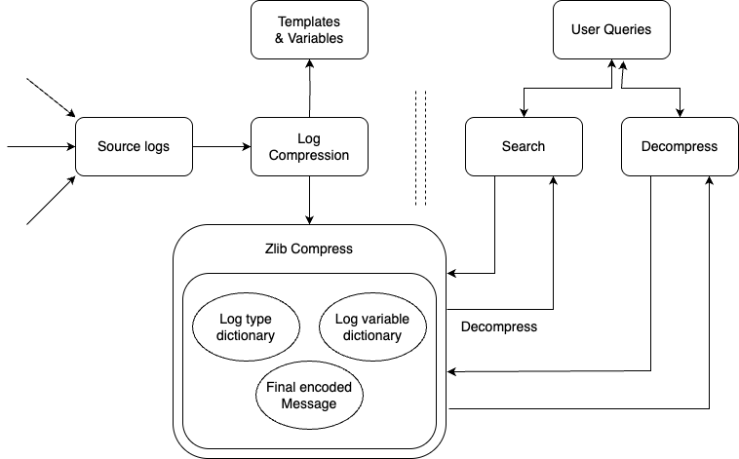
Naïve Approach
It is a normal dictionary-based compression approach.
Its separates static text and variable texts and maps them with different ids.
After mapping we encode the original log with the mapped ids to reduce redundancy.
Also, we store the encoded messages in binary for storage optimization.
Eg. “123456789” will be of 9 bytes if stores as ASCII character.
On the other hand, it will take 4 bytes i.e 32 bits to store the entire number in binary.

Slide 6
Naïve Approach
Advantages
Simple approach with optimized z-lib compression.
Effective for normal textual logs with mixture of repetitive texts and numbers.
Multiple source logs can be fed into the algorithm.
Disadvantages
Entire encoded file and both template and variable dictionaries are stored in RAM.
Harder to scale for big logs due to memory exhaustion.
Really slow for big logs.
Metadata is stored with the compressed file.

Slide 7
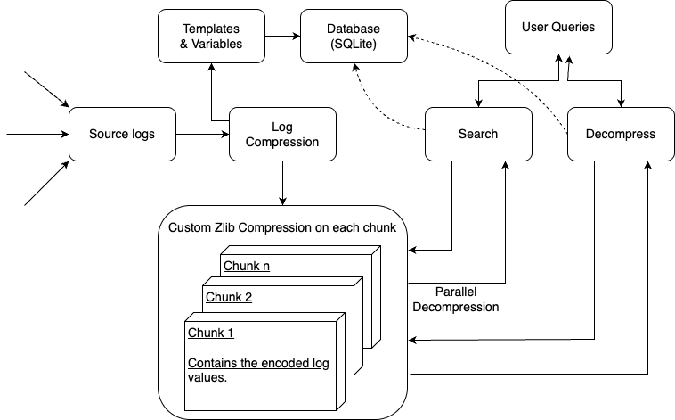
Chunking Approach
Similar to the previous dictionary-based approach with some key changes to fix the shortcomings of the previous approach.
We firstly store the templates and variables in a database to make the algorithm scalable.
Secondly, we distribute the individual encoded logs in chunks/blocks.
Since we are chunking the logs, it opens the door for multithreaded or parallel searching for faster search queries.
And, as we will see in the further slides distributed compression and decompression.

Slide 8
Chunking Approach
Advantages
Optimized z-lib compression for each chunk.
Effective for normal textual logs with mixture of repetitive texts and numbers. Can process 50k lines per second.
Less data to load in RAM. Since we only uncompress one chunk at a time.
Templates and variables (shared metadata) can be used by another machine with similar logs for compression.
Disadvantages
We need to load the entire template dictionary and variable dictionary in RAM. Its still not as big as the log file. Eg. 130 MB for 2 GB log.
It gets progressively slower for bigger logs. Took 3-5 minutes for 3GB logs.
In the worst case, scenario you need to decompress all the chunks for performing search.

Slide 9
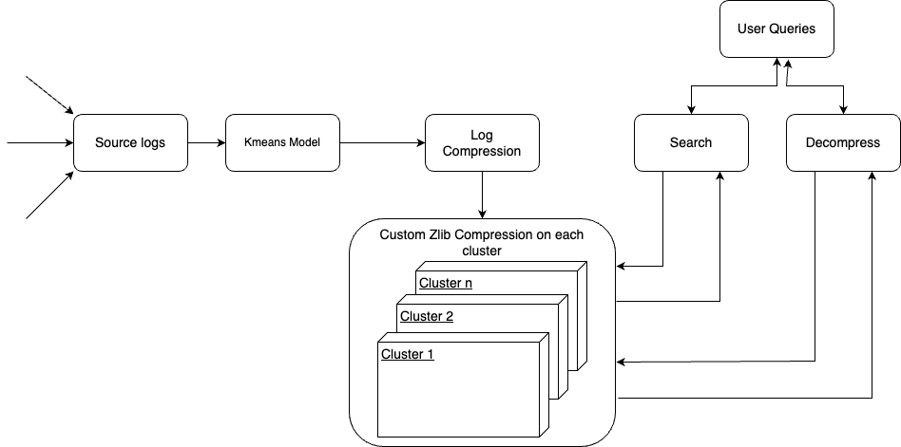
Clustering Approach
Similar to the previous chunking based approach
We firstly cluster logs based upon the uniqueness of templates
For each cluster it separates static text and variable texts and maps
After mapping we encode the original log with the mapped ids to reduce redundancy for each cluster
Use zlib on all the compressed clusters and store the resultant in binary for optimization
These clusters can also be run in distributed environment to increase compression speed
Notes:
The Clustering Approach is similar to the chunking-based approach but adds a layer by grouping logs based on the uniqueness of their templates. Here's how it works:
The process starts with the input logs, which are being processed to extract patterns.
The logs are analyzed to identify common templates, These templates will help group similar logs together.
Based on the uniqueness of these templates, the logs are then clustered. We primarily use kmeans for clustering similar logs together.
Within each cluster, we separate the static template text from the variable text.
The static text is the part that stays the same across logs, and the variable text is the unique part of each log entry.
After separation, we encode the original log entries with mapped IDs for the variable text.
Using compression tools like zlib, all the clusters are further compressed together. This significantly reduces the size of the data for storage.
Searching and lossless decompression are some operations that are operations that are provided to the user
These compressed clusters can then be run in a distributed environment. By distributing the data, we can speed up the compression process

Slide 10
Clustering Approach
Advantages
Searching is done cluster wise
Clusters have similar data that enables efficient compression within the cluster
Enables distributed compression by distributing clusters across multiple machines
Disadvantages
Clustering adds an initial overhead for clustering data
Determining the best number of clusters is challenging and may affect performance
Poor clustered data can lead to ineffective compression and searches
Not ideal for highly variable data
Time consuming process for dividing large datasets into different clusters
Notes:
Let's now discuss the advantages and disadvantages of the Clustering Approach.
Searching can be done cluster wise.
Since each cluster contains similar data, compression within the cluster becomes more effective, helping to reduce the overall storage size.
Clusters can be distributed across multiple machines, enabling parallel processing, which speeds up the compression process and makes it more scalable.
This approach may contain disadvantages with clustering process as the main overhead. This is because it requires time and resources to group the logs effectively before any actual compression or retrieval can happen.
Deciding the optimal number of clusters is challenging, and choosing incorrectly could lead to a dip in performance
If the log data is too diverse and lacks inherent structure, clustering may not perform well, as the log entries will not naturally fit into well-defined groups.
Dividing datasets into smaller clusters can be a time-consuming process, especially as the size of the data increases.
In summary, while the clustering approach brings several benefits, especially in terms of compression and distributed processing, it also requires careful consideration of clustering strategies and data characteristics."

Slide 11
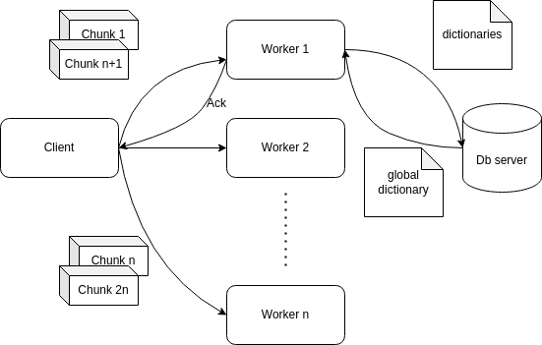
Distributed Chunking
Similar to the Chunking approach we the client first distributes all the chunks to the workers.
We parse the templates and send them to the DB server to convert them to global Dictionaries with respective IDs.
The DB server then sends the global dictionaries back to the workers to convert the parsed logs to original logs in their respective machines.
It builds on the previous work so we can leverage multithreading searching and decompression.
The compression ratio remains the same as the there is nothing repeated between the workers.
Notes:
I worked on building upon the work done by Neel on the chunking approach and making it distributed environment.
All the requests for compression and decompression are done by the client.
The client then splits all the files into chunks and sends them in round robin to all the worker nodes.
The worker nodes parse the chunks into templates and variables which are sent to the db server which them converting them to their global dictionary.
The global dictionary is sent back to all the workers for writing their parsed logs back to their local archives.
For decompression we do almost the same thing.
We ask the db server for the global dictionary which is used to convert the local archives to logs for decompression
and the workers send the decompressed logs to the client.

Slide 12
Distributed Chunking
Advantages
Horizontally scalable for worker nodes.
Dividing the workload among multiple workers helps mitigate the performance penalty associated with larger log sizes.
Can be used for low RAM machines as workers since chunks are smaller.
Zero extra storage overhead as compared to the single machine approach.
Disadvantages
Single point of failure for this architecture (this can be avoided by using distributed kv like Redis)
High communication overhead of sending and receiving the chunks and dictionaries(this can be avoided by caching the dictionaries after each query)
Complex concurrency issues and global state management.

Slide 13
Experimental Setup
System:
OS: MAC OS
C++ 17 (Clang/g++)
zlib 1.3.1
SQLite 3.49
Docker (For distributed approach)
Go 1.22
Datasets used from Loghub. From applications such as hive, HDFS, BGL, Android, Mac, Backend application logs, Spark, SSH.

Slide 14
Results

Slide 15
Results

Slide 16
Results

Slide 17
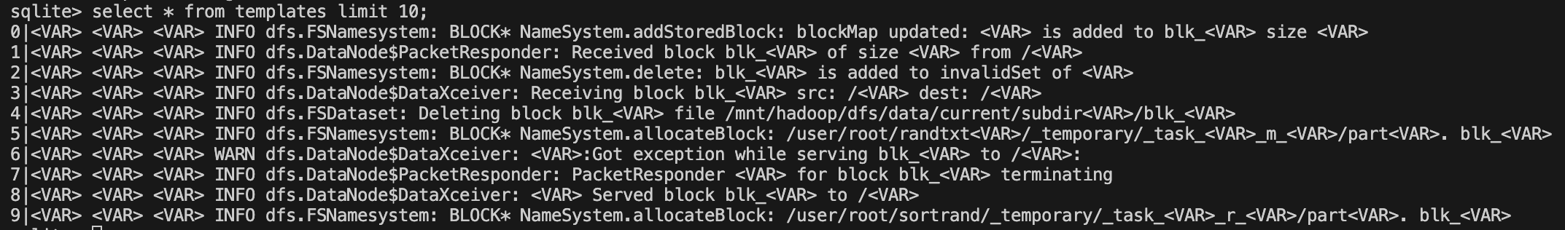
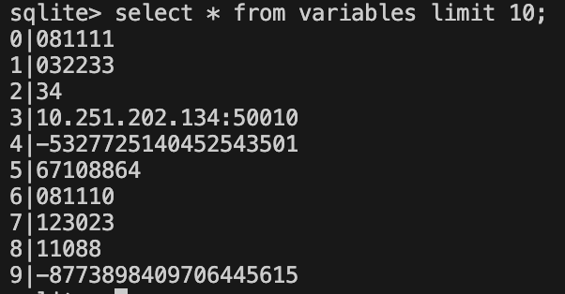
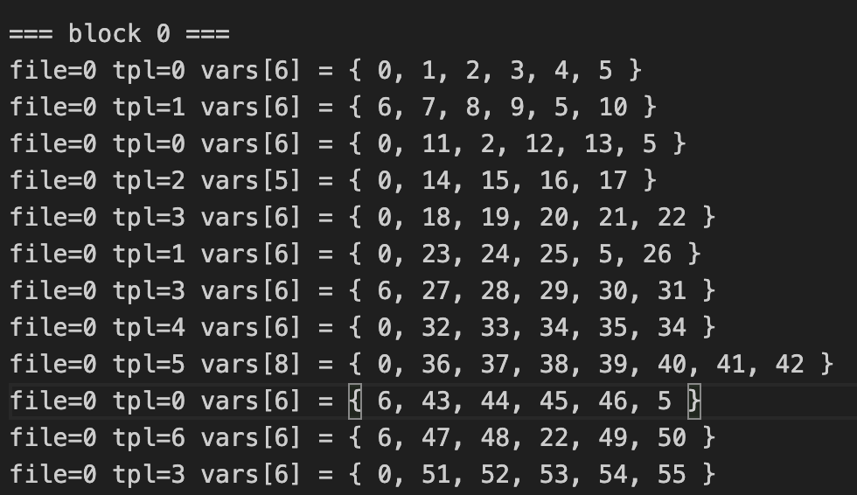
Results

Slide 18
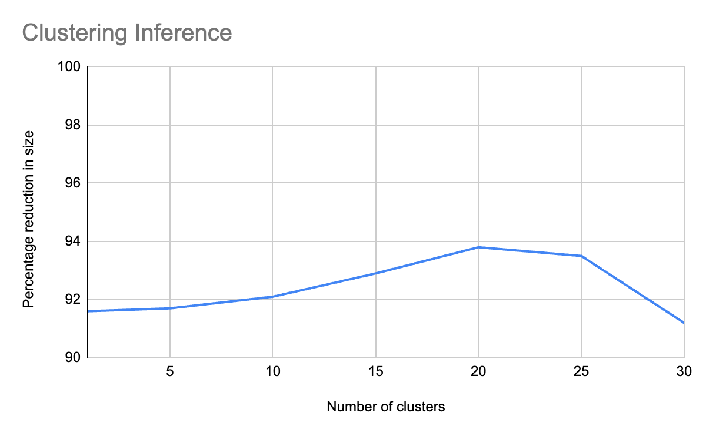
Optimal Value for K in HDFS

Slide 19
Searching (Static query)

Slide 20
Searching (Wildcard Query)

Slide 21
Future Scope
Optimize the regex engine to get better compression speeds.
Seperating Metadata and compressed logs open ups the door for distributed compression and decompression that we have implemented for Logpress (chunking).
Exploring better clustering algorithm for textual logs can improve the performance of clustering approach.
Test the distributed approach in real environment with limited bandwidth. Eg. VCL, AWS EC2.
Using columnar compression based Database can be helpful in reducing the metadata size in DBs. Eg. DuckDB or store only the difference.

Slide 22
Conclusion
Logpress (Chunking) outperforms the industry standard algorithm i.e Gzip and Tarzip and it performs subpar compared to CLP (state of art approach).
As per our approaches & results we found that the dictionary based approach outperforms the clustering based approach.
K-means has shortcoming for finding the optimal K value as per the dataset. Also, the processing time is slow.
Both the dictionary based chunking and clustering can be distributed between different machines for faster compression.

Slide 23
Questions ?

